Slide 1
Other Road Users
Friend or Foe?

Slide 2
Contents
Road Users of Today
Background
Road Users & Dynamic Environment
Road Users of Tomorrow
Short Term Future
Long Term Future

Slide 3
Road Users of Today
Background

Slide 4
Background

Slide 5
Road Users of Today
Road Users and Dynamic Environments

Slide 6
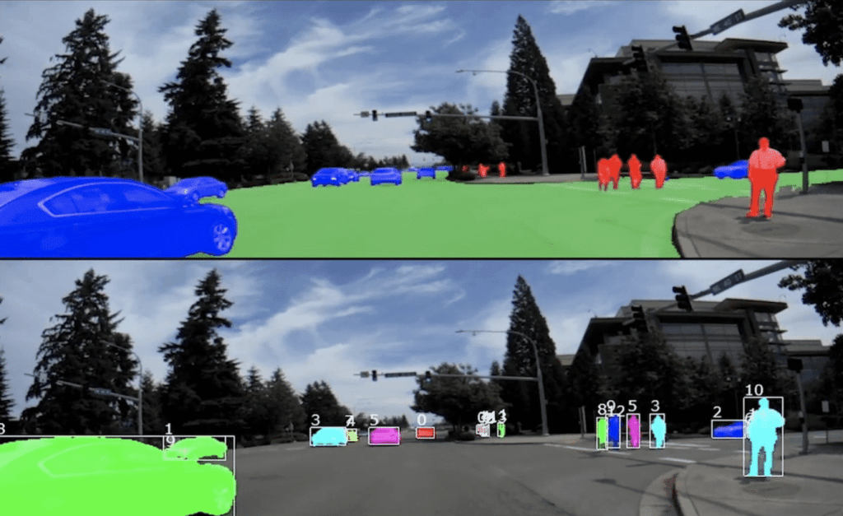
Road Users & Dynamic Environments

Slide 7
Road Users & Dynamic Environments

Slide 8
Road Users of Tomorrow
Short Term Future

Slide 9
Short Term Future – V2V

Slide 10
Road Users of Tomorrow
Long Term Future

Slide 11
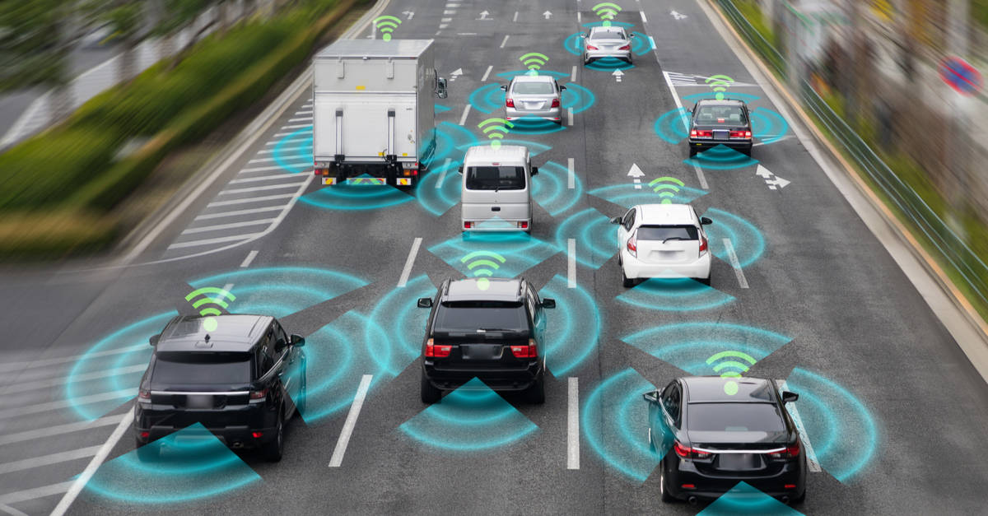
Long Term Future – Hive Autonomy

